Slide 1
Impact of Cloud Computing on Businesses
Cloud Computing has become a disrupting technology that is replacing the IT infrastructure used by small and large enterprises. By using Cloud Computing, enterprises can do away with many captive datacenters and server-storage infrastructure owned and managed by them.
Several IT hardware manufacturers, application developers, and datacenter product providers will lose a lot of revenue because of the use of cloud, as customers will stop buying hardware and software applications in preference for cloud services.
Pay-per-use invoices and On-demand resource

Slide 2
A cloud service has a few salient features that distinguish it from hosting
services. These features are given as follows:
Cloud services are sold on demand, typically by the minute, hour, or month.
You as a user can use as much or as little of a service as you want at any time.
The service can be an application or even hardware resources, such as storage capacity or compute power.
The service and underlying infrastructure is fully managed by the provider. All you need is a Web browser and an Internet connection.

Slide 3
A cloud service can be public, private, or a hybrid of the two. A public cloud offers services to anyone on the Internet. Amazon Web Services, Google, and Salesforce.com are some of the leading public cloud providers.
A private cloud is an internal IT infrastructure, usually located within the user’s datacenter. It offers application services to a limited number of users within one or a few related organizations.
Like a public cloud, the infrastructure is shared by multiple users and each user gets resources as and when he/she requires.

Slide 4
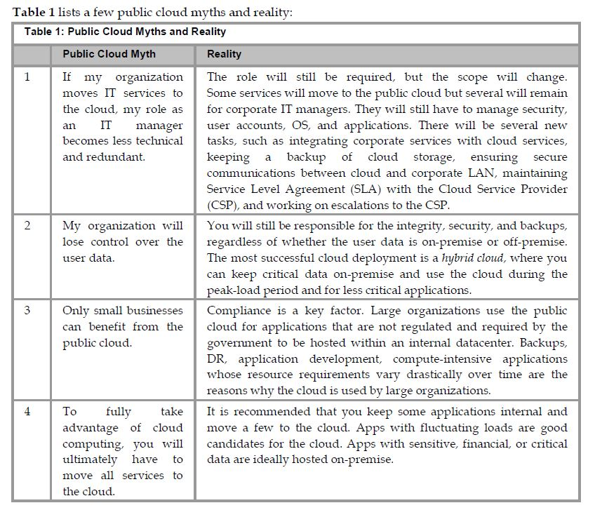

Slide 5
Cloud Computing Service Delivery Models
There are three high-level cloud models depending on what resources you use and the benefits you get from the cloud. These are described as follows:
Infrastructure-as-a-Service (IaaS)—In this model, you can either use servers or storage in the cloud. In this model, you do not have to purchase and maintain your own IT hardware. However, you need to install your applications on your cloud-based hardware resources.
Platform-as-a-Service (PaaS)—In this model, you can use the cloud as a platform to develop and sell software applications.
Software-as-a-Service (SaaS)—In this model, you can use various software applications, such as CRM and ERP, and collaboration tools on the Web. You save by not having to buy or maintain IT hardware or applications.
Business Process as a Service (BPaaS)—In this model, you can use a combined model that includes Human Capital Management (HCM) as offered by Workday and parts of ERP, such as Supply Chain Management and Vendor Management.

Slide 6
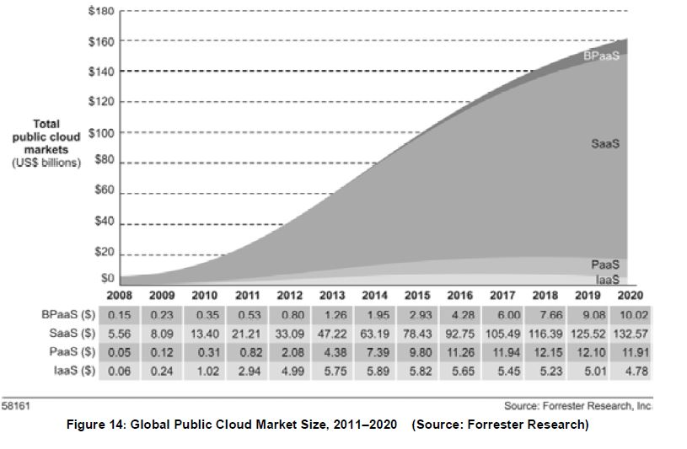
In each of the above cases, you pay a monthly fee to the cloud provider for the hardware or applications you use. Figure shows the projected market size for the public cloud, which it is expected to touch by the end of this decade:

Slide 7
The fastest growing segments in SaaS are Content, Communications and Collaboration (CCC), Customer Relationship Management (CRM), Enterprise Resource Planning (ERP), and Supply Chain Management (SCM).
A strong SaaS adoption will lead to more growth of IaaS and PaaS.

Slide 8
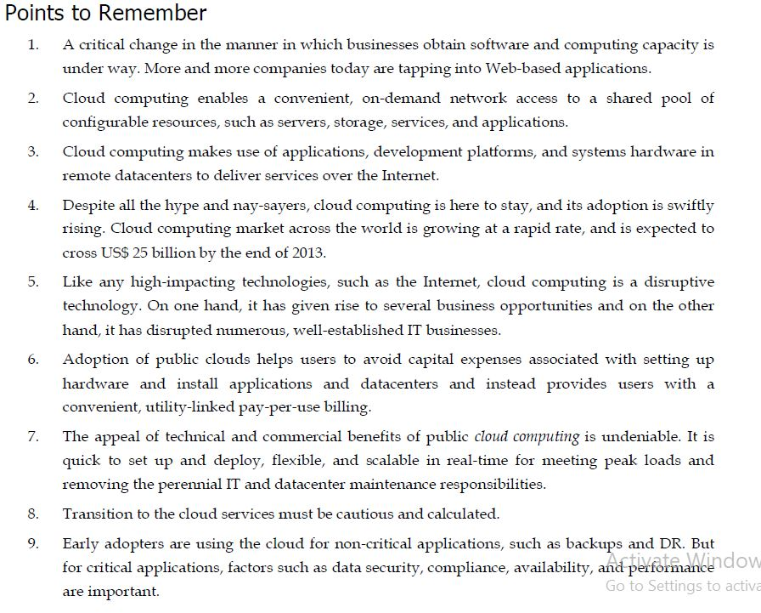
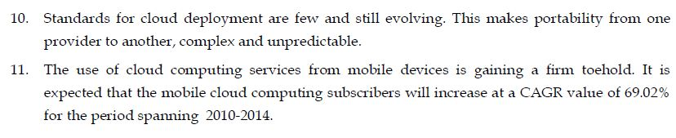

Slide 9
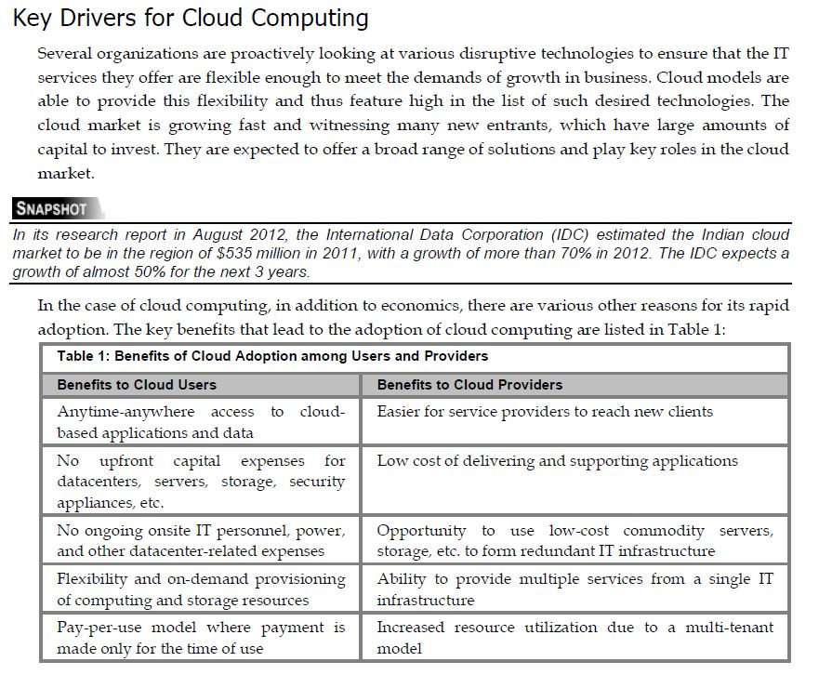

Slide 10
The popularity of cloud computing, especially among Small and Medium Businesses (SMBs), is undeniable, and they use cloud computing for internal and mission-critical purposes.
Large corporations use public clouds for less critical applications such as Disaster Recovery (DR) and backups. However, now, they are evaluating or using cloud computing for mission-critical services such as Customer-Relationship Management (CRM) and Enterprise Resource Planning (ERP). They are also motivated by the cloud’s large-scale, on-demand resource availability and ease of use. The key benefits for SMBs and enterprises are as follows:
Scalability—It is the ability of the cloud service or application to grow or diminish the resources(CPU, RAM, bandwidth, storage) based on need. This is often done without human ntervention.
Ease of Use—A self-service portal makes it easy to configure and use cloud resources. If a new virtual machine is required for test, development, or production, it can be quickly setup and put to use in a matter of minutes, compared to on-premise procurement and configuration, which takes more than a week.
Risk Reduction—SMBs and enterprises can use the cloud to build IT configurations to experiment with new business ideas, technologies, and models, before making large-scale investments.

Slide 11
Reduced Capital Expenses (CapEx)—There is no upfront capital investment in the physical resource procurement, maintenance, upgrade, or administrative costs.
Pay-for-What-You-Use—The organization is billed for what they have used during the month.
Lower Operating Expenses (OpEx)—The cost for cloud resources and support manpower is shared by many consumers and the utilization percentage is high. Thus, the consequential economies of scale help lower the cost for consumers.
Flexibility to Hire Talent—A business can have employees spread across the world and have them work on a common cloud-based platform. This enables an organization to use the best talent available at the lowest cost.
Collaboration—Anytime-anywhere access enables employees and partners to work concurrently on common projects.
Assurance with Service Level Agreements (SLAs)—The consumer or business has an agreement with the provider for a certain level of uptime, performance and problem response,and resolution time.

Slide 12
Cloud Computing and Outsourcing
The justification for IT outsourcing and cloud computing has been instrumental in lowering of costs. Contracting a business or IT function to another organization characterizes outsourcing. Cloud sourcing is about leveraging of services hosted at a third-party site for computing resource or applications. It replaces the need for dedicated IT capabilities and staff, which are usually more expensive.
Cloud-sourcing can provide substantial economic benefits, but there are disadvantages to consider too such as security, loss of control, and performance. However, it is important to understand the similarities and differences between the two, as shown in Table :

Slide 13
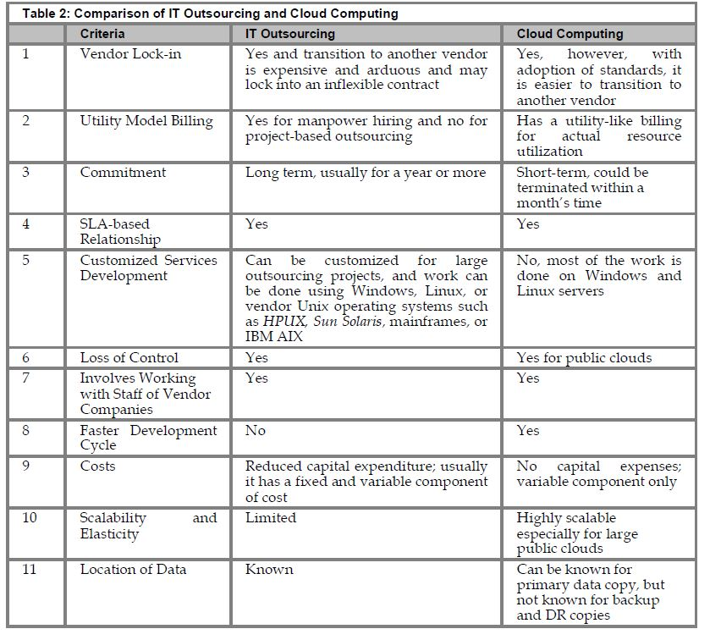

Slide 14
It is important to realize that there are compliance and government regulations for location of data and it applies to both cloud computing and outsourcing.
Other concerns for both are:
Security at a vendor site
Loss of control
Latency of using an application at a remote site

Slide 15
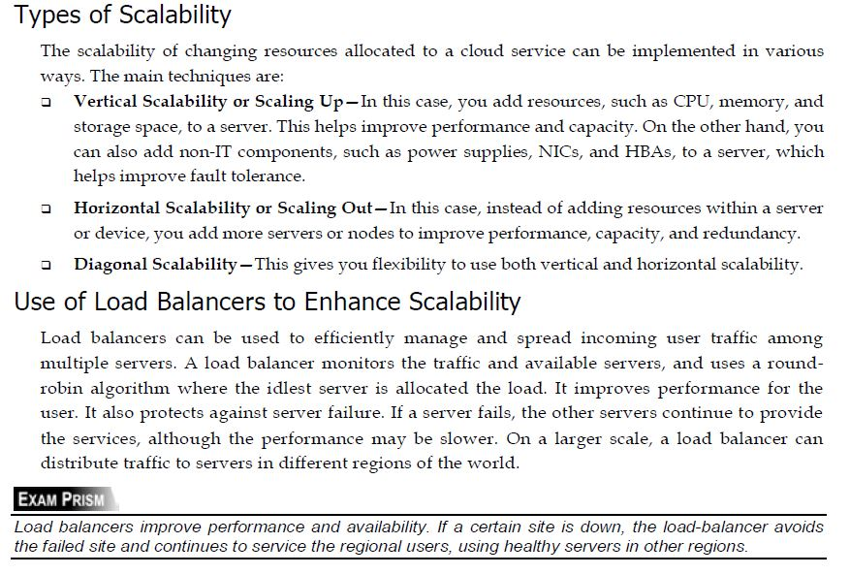

Slide 16
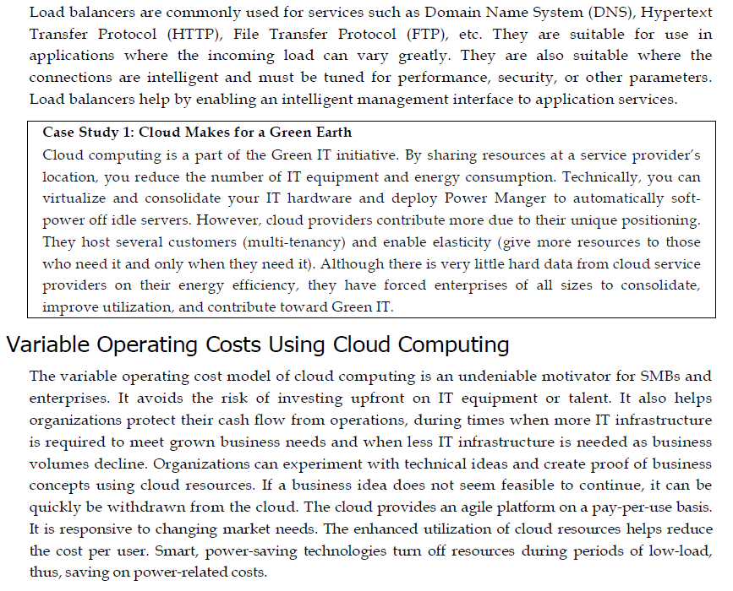

Slide 17
Variable Operating Costs Using Cloud Computing
The variable operating cost model of cloud computing is an undeniable motivator for SMBs and
enterprises. It avoids the risk of investing upfront on IT equipment or talent.
It also helps organizations protect their cash flow from operations, during times when more IT infrastructure is required to meet grown business needs and when less IT infrastructure is needed as business volumes decline.
Organizations can experiment with technical ideas and create proof of business concepts using cloud resources.
If a business idea does not seem feasible to continue, it can be quickly be withdrawn from the cloud.
The cloud provides an agile platform on a pay-per-use basis.
It is responsive to changing market needs.
The enhanced utilization of cloud resources helps reduce the cost per user. Smart, power-saving technologies turn off resources during periods of low-load, thus, saving on power-related costs.

Slide 18
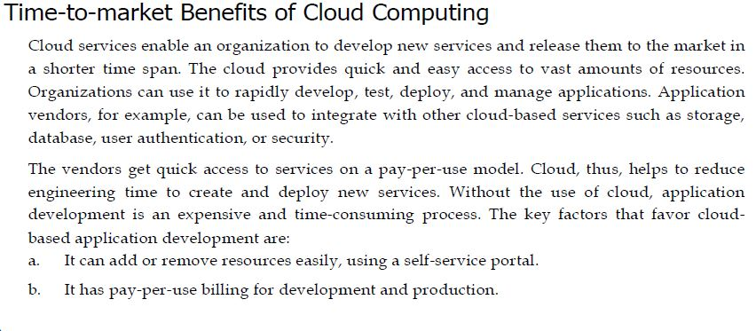
It has support for three-tier or multi-tier application architecture.
d. It has an easy mechanism to migrate existing virtual server images to the cloud.

Slide 19
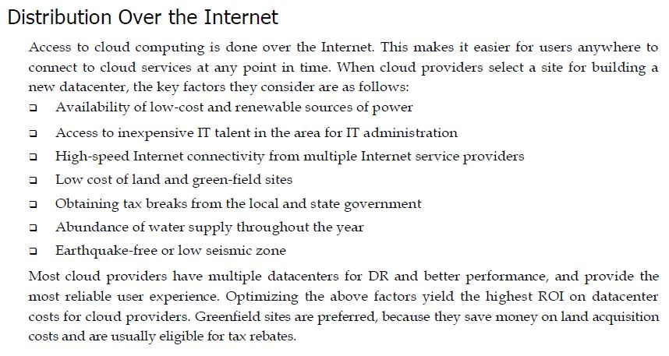

Slide 20
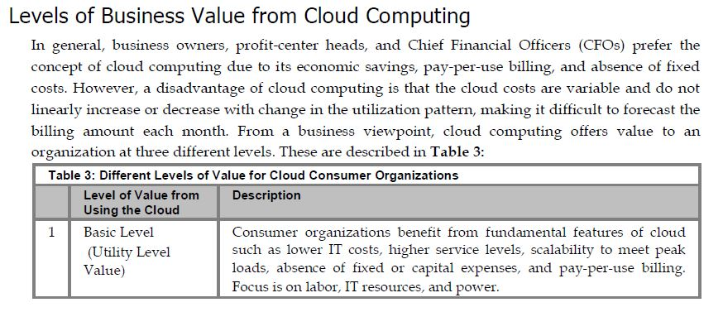

Slide 21
